Slide 1

Compilers Theory
Lab 1

Slide 2
Agenda
Course Orientation
Introduction to Compilers
Regular Expressions
Appendix (Self-Study)

Slide 3
Course Orientation

Slide 4
Course Orientation
Prepare a team of 6 members for the project
Registration Form:
  Deadline: Saturday, October 3, 2026, at 8 PM.
  Link: https://forms.gle/Mv1Pkb9YkJGggYtS7
Registration Form for Unregistered Students:
  This form will be opened on Saturday, October 3, 2026, at 8 PM.
  Deadline: Monday, October 5, 2026, at 8 PM.
  Link: https://forms.gle/bW9rTjAU9DGBjSGZ6
2 Quizzes
Project will be delivered in 3 Milestones.

Slide 5
Course Orientation
Having an issue? Feel free to contact me
AL. Aya Saad: aya.saad@cis.asu.edu.eg
Mena Elkholy: menna.elkholy@cis.asu.edu.eg
TA. Martina Elkes: Martina.alkesAngelos@cis.asu.edu.eg

Slide 6
Introduction to compilers

Slide 7
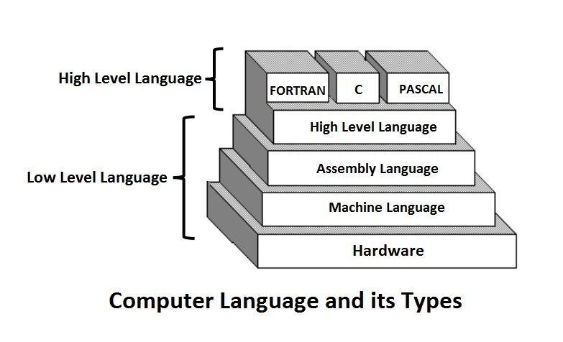
Introduction to Compilers
Compiler
Assembler
0’s & 1’s
Notes:
Crack for a program with license code.
Opposite:
Program that translates machine language to assembly is called a Disassembler
Program that translates an executable file to high-level source code is called a Decompiler.

Slide 8
Introduction to Compilers
Compilers are computer programs that translate from language to another. (translates high-level language program into low-level machine language.)
Why are Compilers important?
  Much easier for the programmer to write high-level language and focus on solving problems.
  Compilers can spot programming mistakes.
Source
Program
Compiler
Target
Program
Notes:
The main purpose of compiler is to change the code written in one language without changing the meaning of the program.

Slide 9
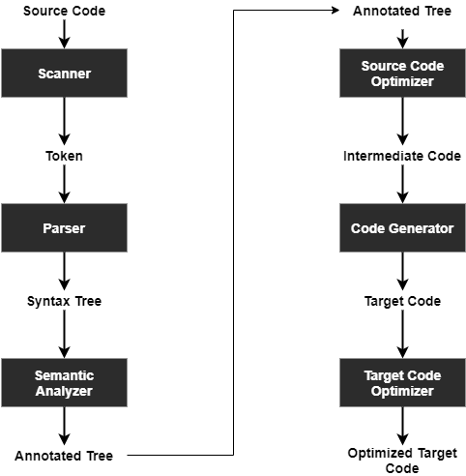
Compiler Phases
Notes:
In the Lexical Analysis Phase, the compiler reads the actual source program and collects sequences of characters into meaningful units called tokens

Slide 10
Introduction to Regular Expressions
Notes:
Kleene’s Regular Expressions at: http://www.cs.columbia.edu/~aho/cs3261/Lectures/L3-Regular_Expressions.html#:~:text=Kleene%20regular%20expressions.-,Kleene%20regular%20expressions,-We%20can%20specify
POSIX Regular Expressions at : http://www.cs.columbia.edu/~aho/cs3261/Lectures/L3-Regular_Expressions.html#:~:text=4.-,POSIX%20Regular%20Expressions,-The%20IEEE%20standards

Slide 11
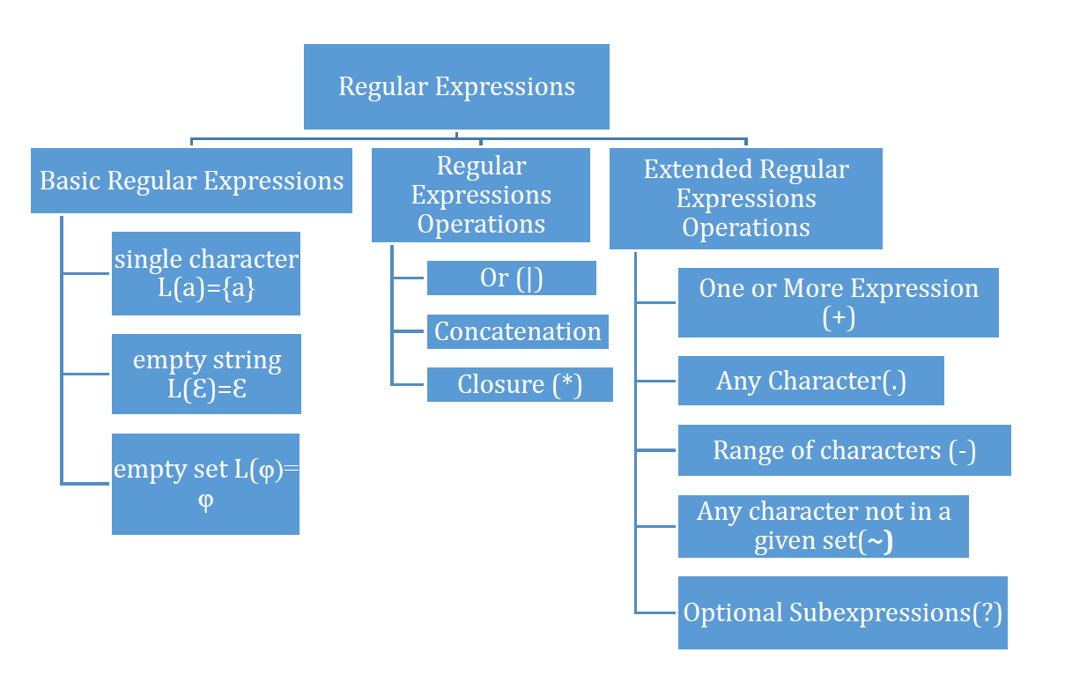
Regular Expressions (RE)
RE is a notation for specifying patterns and to represent the language for lexical analyzer.
Notes:
Remember in the Lexical Analysis Phase, the compiler reads the actual source program and collects sequences of characters into meaningful units called tokens. Which is essentially a pattern matching step.

Slide 12
Examples on Regular Expressions
Write a regular expression for a language which accepts string 01 and all strings which starts with 1 and ends with at least one occurrence of 1, over the following alphabet ∑ = {0, 1}.
Solution:
L = {01, 1, 11,10101,100001,….}
R = (01) | 1(0|1)* 1|(1)

Slide 13
Examples on Regular Expressions cont.
Write the regular expression for the language accepting all the string which are starting with 01 or ending with 01, over alphabet ∑ = {0, 1}.
Solution:
L = {01, 0101, 0100, 0111, 0011101, 0100010101, …}
RE = 01(0|1)* | (0|1)*01
Write the regular expression for the language accepting at least two consecutive zeros or ones, over ∑ = {0, 1}.
Solution:
L = {00, 11, 0010, 11010, 0101101, 1010011, …}
RE = (0|1)*00(0|1)* | (0|1)*11(0|1)*

Slide 14
Examples on Regular Expressions cont.
Write the regular expression for the language accepting all the string which are ending with 01, over ∑ = {0, 1}.
Solution: (0 | 1)*01
Considering the following regular expression which string is not in the language?
(a|b)* a (a|b)*
  A. ba B. ab C. a D. b
Which one of the following language over the alphabet {0,1} is described by the regular expression: (0|1)*0(0|1)*0(0|1)*
  The set of all strings containing the substring 00.
  The set of all strings containing exactly two 0’s.
  The set of all strings containing at least two 0’s.
  The set of all strings that begin and end with either 0 or 1.

Slide 15
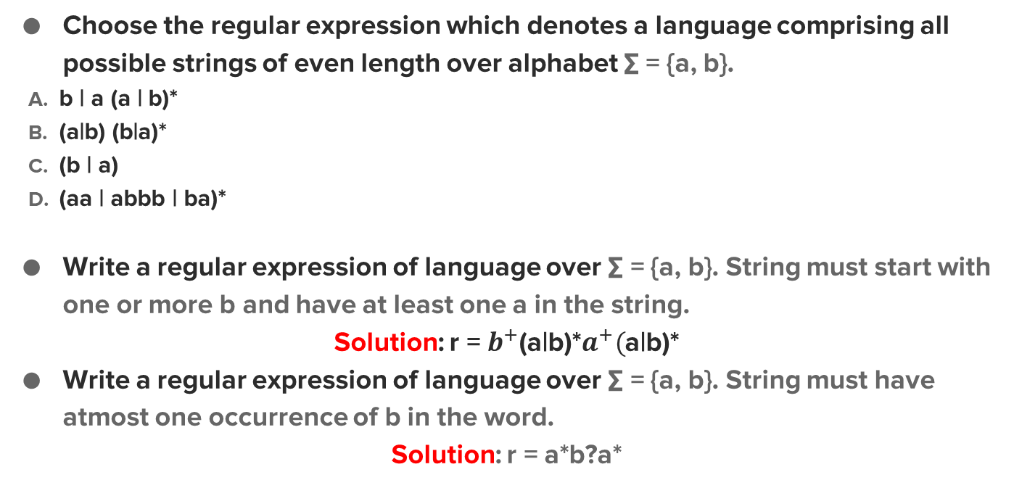
Examples on Regular Expressions cont.

Slide 16
Examples on Regular Expressions cont.
Exercises: Write the regular expression which represent the following languages
1) All strings of lowercase letters that begin and end in a
Solution: a[a-z]*a |a
2) All strings of lowercase letters that either begin or end in a (or both)
Solution: a[a-z]* | [a-z]*a
3) All strings of digits that contain no leading zeros
Solution: [1-9][0-9]*
4) All strings of digits that represent even numbers
Solution: [0-9]*[0|2|4|6|8]

Slide 17
More Examples on Regular Expressions cont.
All strings of a’s and b’s that don’t contain three-consecutive b’s
Solution: (a|ba|bba)*(b|bb)?

Slide 18
More Examples on Regular Expressions cont.
All strings of a’s and b’s that contain an odd number of a’s or an odd number of b’s (or both)
Solution: b*ab*(ab*ab*)* | a*ba*(ba*ba*)*
Σ = {a, b}, Strings that contain exactly as many a’s as b’s.
Solution: Cannot be expressed by a regular expression, since the only repetition in R.E is Closure(* and +), and it cannot be restricted.
Notes:
1- Steps:
a b
a(aa)* b(bb)*
b*a(aa)* a*ba*(bb)*
Answer: b*ab*(ab*ab*)* | a*b(ba*ba*)*

Slide 19
More Examples on Regular Expressions cont.
Write an English description for the languages generated by the following regular expressions
1) (a|b)*a (a|b|c)
Solution: All lowercase strings over a and b that end with aa, ab or ac.
2) (aa|b)*(a|bb)*
Solution: All Strings over a & b except that has odd number of a‘s followed by odd number of b‘s .
Notes:
2- Examples:
aa b
aa bb
aa a a bb a bb a a a bb bb
aa b aa aa b b b b a bb a bb bb

Slide 20
More Examples on Regular Expressions cont.
Let Σ = {a, b} and L = { w ∈ Σ* | w does not contain bb as a substring }
Solution:
(a | ba)* b?
Test
aaaa
baaaaaaba
babba

Slide 21
Questions?

Slide 22
Appendix

Slide 23
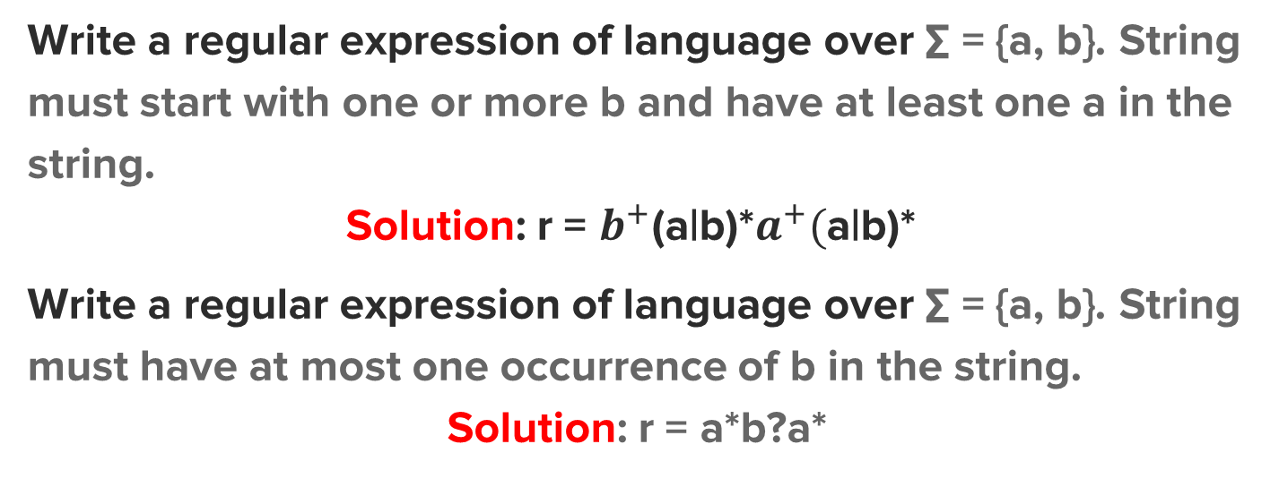
MORE EXAMPLES (SELF STUDY)

Slide 24
MORE EXAMPLES (SELF STUDY)
All strings of lowercase letters that begin and end in a
Solution: a[a-z]*a |a
All strings of lowercase letters that either begin or end with an ‘a’ (or both)
Solution: a[a-z]* | [a-z]*a | a[a-z]*a
All strings of digits such that all the 2’s occur before all the 9’s
Solution: [0-8]* [0|1|3-9]*

Slide 25
MORE EXAMPLES (SELF STUDY)
Write an English description for the languages generated by the following regular expressions
(A|B|…Z) (a|b|…|z)*
Solution: Any string that begins with an uppercase letter then all letters are lowercase.
(0|1|…9|A|B|C|D|E|F)⁺(x|X)
Solution: Strings are either a digit or an uppercase letter from A to F concatenated with an X or x.

Slide 26
MORE EXAMPLES (SELF STUDY)
Example (1)
Let Σ = {0, 1}
Let L = { w ∈ Σ* | w contains at most one 0 }
Solution:
1*(0 | ε)1*
1*0?1*
Example (2)
Let Σ = { a, b}
Let L = { w ∈ Σ* | w with at least three a’s}.
Solution: b* ab* ab*a (a|b)*
Test
11110111
111111
0111
0
Test
abababab
aaba
aa

